Slide 1

Exam AZ-303: Microsoft Azure Architect Technologies Crash Course
Tim Warner

Slide 2


Tim Warner
Based in Nashville, TN, US
MCT, MVP
Twitter: @TechTrainerTim
Badge: TechTrainerTim.com

Slide 3
Day 1 of 2 Agenda
Introduction
Implement and Monitor Azure Infrastructure
Implement Cloud Application

Slide 4
Day 2 of 2 Agenda
Implement Governance and Security Solutions
Implement and Manage Data Platforms
Exam AZ-303 Strategy

Slide 5
Course Materials
timw.info/az303

Slide 6
A Different Kind of Training
Let's avoid slide show fatigue
We'll learn by doing – at least 80 percent demo
Case study approach
This is an expert certification, so we will move quickly and assume intermediate-level Azure skills
10-minute break at midpoint
I’m here to answer your questions – take advantage of this!
Use the Q&A panel

Slide 7

Session Recordings

Slide 8
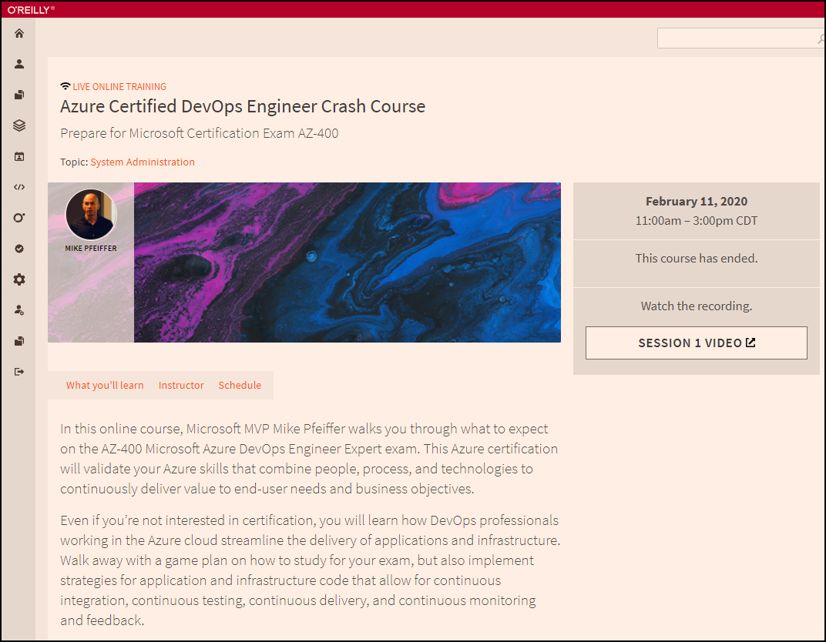
Session Recordings

Slide 9

Session Recordings

Slide 10
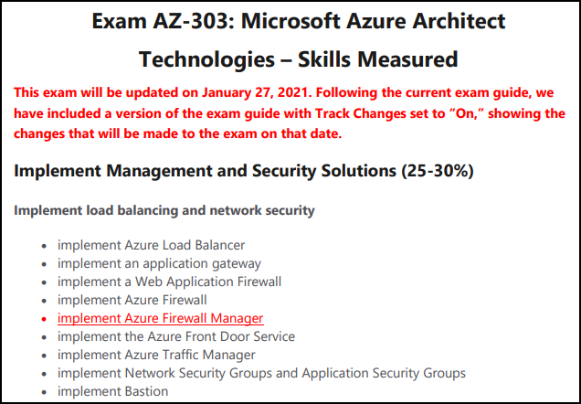
Azure Architect 2021 Changes

Slide 11
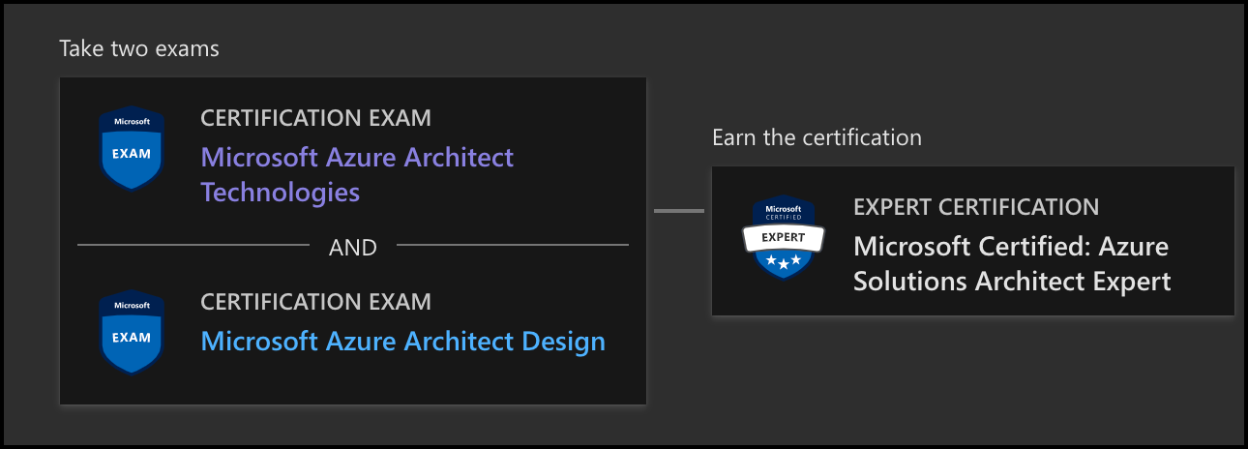
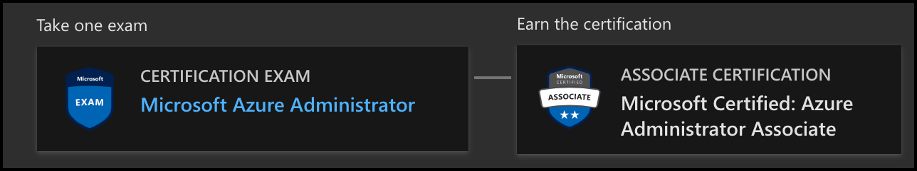
Azure Architect Facts and Tips
AZ-303
AZ-304
AZ-104

Slide 12
Tim's Certification Study Pyramid
Interdependence
Content knowledge
Practical application
Test-taking skills

Slide 13
Thank you!
Course materials: timw.info/az303
Twitter: @TechTrainerTim
Work: timw.info/ps
Web: TechTrainerTim.com

Slide 14
Azure Compute

Slide 15
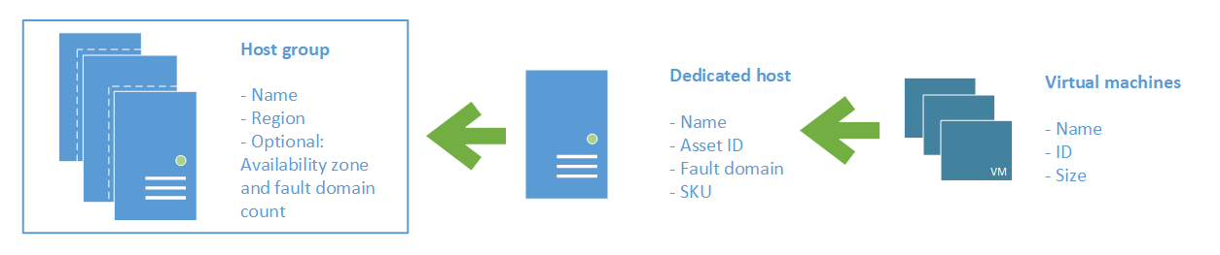
Azure VM Dedicated Host

Slide 16
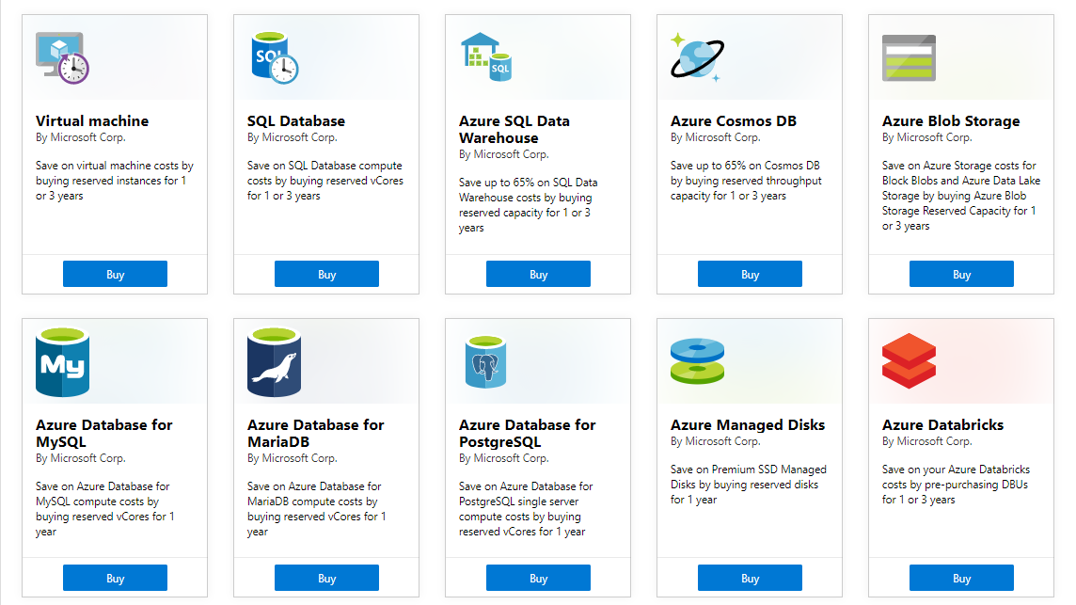
Azure Reservations

Slide 17

VM Scale Sets

Slide 18
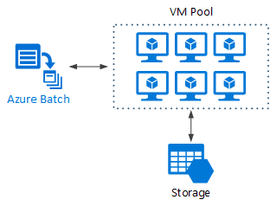
Azure Batch

Slide 19

Availability Set

Slide 20

Availability Zone

Slide 21






Azure App Service
Web Apps
Web Apps for Containers
API Management
Functions
Logic Apps

Slide 22


Docker Lifecycle
https://timw.info/89a04

Slide 23



Running Containers in Azure
Azure Container Instances
Azure Container Registry
Azure Kubernetes Service (AKS)

Slide 24
Load Balancing

Slide 25

VM Networking

Slide 26

Load Balancing

Slide 27

VNet Peering

Slide 28

Hybrid Networking

Slide 29

Network Virtual Appliance

Slide 30

Azure Load Balancer

Slide 31

Application Gateway

Slide 32
Authentication

Slide 33

Azure Subscriptions

Slide 34

Azure Management Scopes
/ Tenant root
Inheritence:
RBAC
Policy
No inheritence:
Tags

Slide 35

Hybrid Identity

Slide 36

Passthrough Authentication

Slide 37

Seamless Single Sign-on

Slide 38
Azure Storage

Slide 39
Storage Account Replication
1
3
3
2
LRS
ZRS

Slide 40
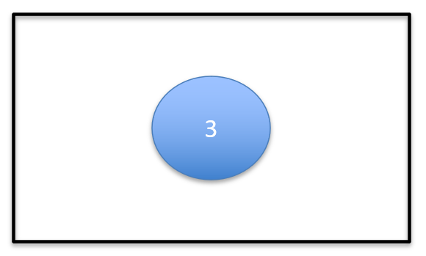
Storage Account Replication
1
3
1
3
2
2
GRS / RA-GRS

Slide 41
Storage Account Replication
1
3
1
3
2
2
GZRS / RA-GZRS

Slide 42

Traffic Manager

Slide 43

Front Door Service

Slide 44
Governance

Slide 45

Tenant vs. Subscription

Slide 46
Azure Management Scopes
/ Tenant Root

Slide 47
App Architecture

Slide 48


Docker Container Lifecycle
https://timw.info/3635f

Slide 49

Event Architecture

Slide 50
Data Platform

Slide 51

Always Encrypted

Slide 52
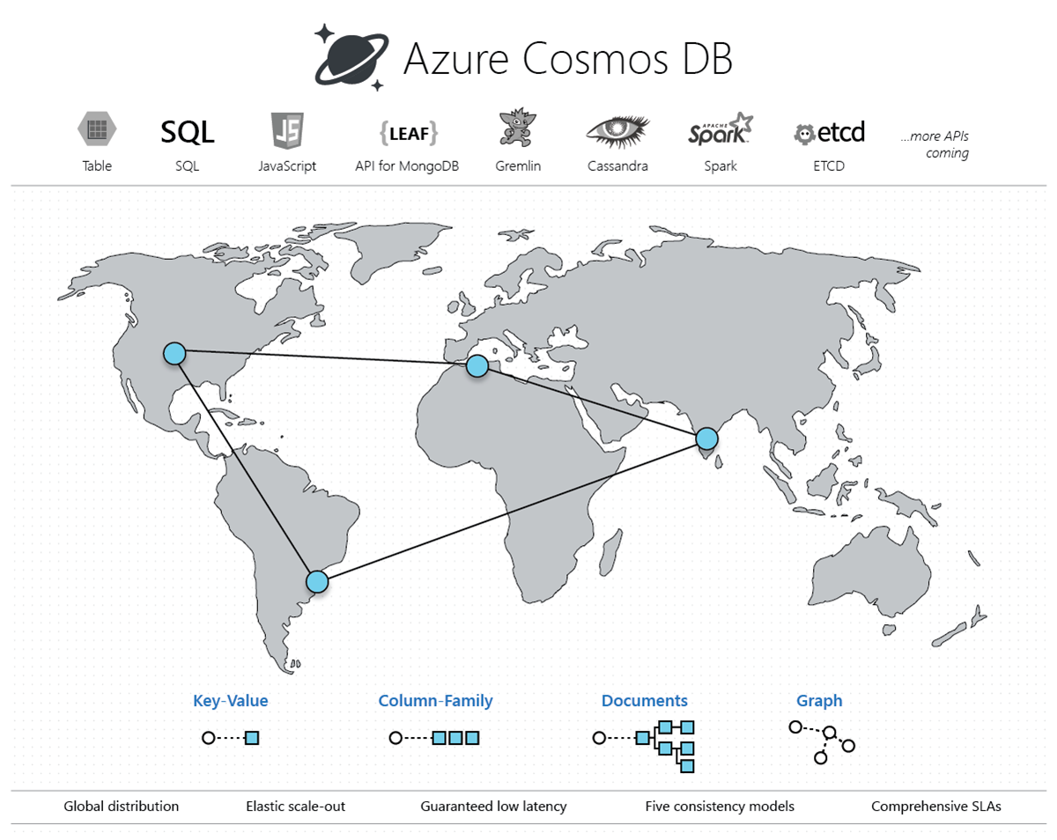
Cosmos DB

Slide 53
Exam AZ-303 Item Types

Slide 54

Multiple Choice

Slide 55
Repeated Scenario
You need to move an Azure VM to another hardware host.
Solution: You redeploy the VM.
Does this solution meet the goal?
Yes
No

Slide 56

Select and Place

Slide 57

Build List and Reorder

Slide 58

Active Screen/Fill in the Blank

Slide 59

Case Study

Slide 60






Performance-Based Lab

Slide 61
Microsoft Online Testing

Slide 62
Microsoft Online Testing Process
timw.info/online

Slide 63

Microsoft Online Testing Process

Slide 64

Microsoft Online Testing Process

Slide 65

Microsoft Online Testing Process

Slide 66

Microsoft Online Testing Process

Slide 67

Microsoft Online Testing Process

Slide 68

Microsoft Online Testing Process

Slide 69

Microsoft Online Testing Process

Slide 70
AZ-303 Exam Strategy
Focus your skills accordingly:
60 percent Azure portal
20 percent Azure PowerShell
10 percent Azure CLI
10 percent KQL
Expect performance-based labs, but be thankful if you don't see 'em

